Slide 1
ECE – 304 Junior Design Project
Spring 2022
David McLaughlin, Professor
Department of Electrical & Computer Engineering
University of Massachusetts at Amherst
Systems Requirement Document
Lecture 2 - 2/12/21 – Requirements & Block Diagrams

Slide 5
Dog House
Requirements Case Study
Source: Raytheon Principles of Systems Engineering Course Manual
Reproduced and used as the basis for the Umass Amherst course ECE-597SE, Introduction to Systems Engineering

Slide 6
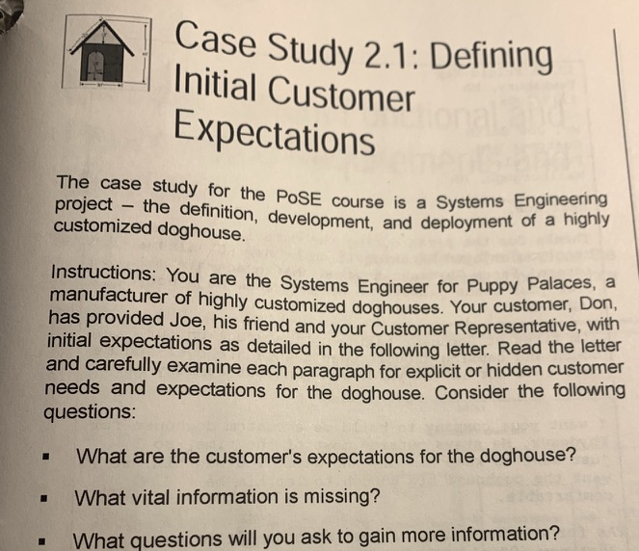
Source: Raytheon Principles of Systems Engineering (PoSE) Course Manual.Reproduced and used as the basis for the course ECE-597SE, Introduction to Systems Engineering

Slide 7
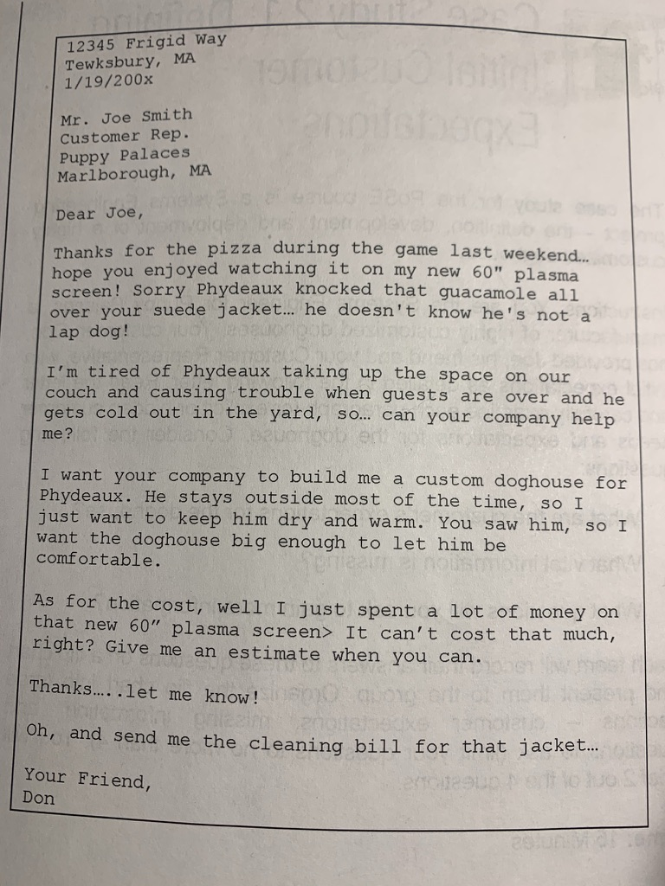
Initial Customer Letter
Source: Raytheon Principles of Systems Engineering (PoSE) Course Manual.Reproduced and used as the basis for the course ECE-597SE, Introduction to Systems Engineering

Slide 8
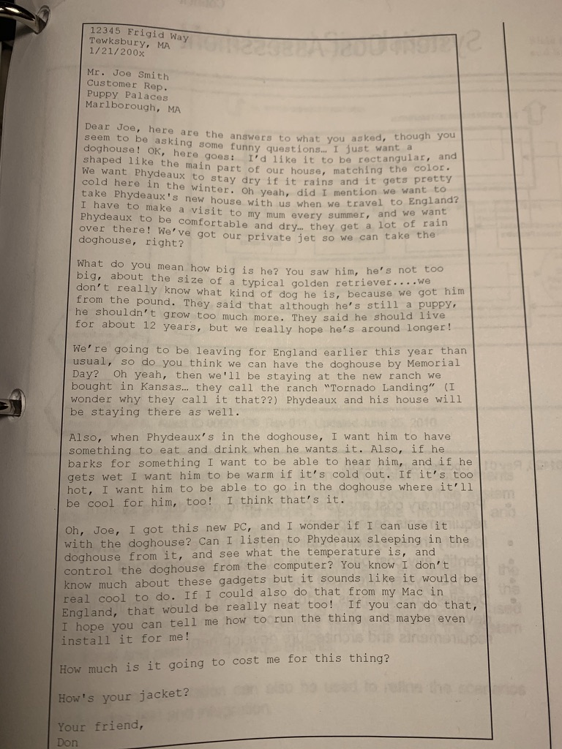
Follow-up customer letter
fit into private jet
tornado
food/drink on dog demand
if dog gets wet, I want him warm if its cold out
sensors on dog??
temp control (heating & cooling)
audio, temp monitor
& control; PC & MacOS
Source: Raytheon Principles of Systems Engineering (PoSE) Course Manual.Reproduced and used as the basis for the course ECE-597SE, Introduction to Systems Engineering

Slide 9
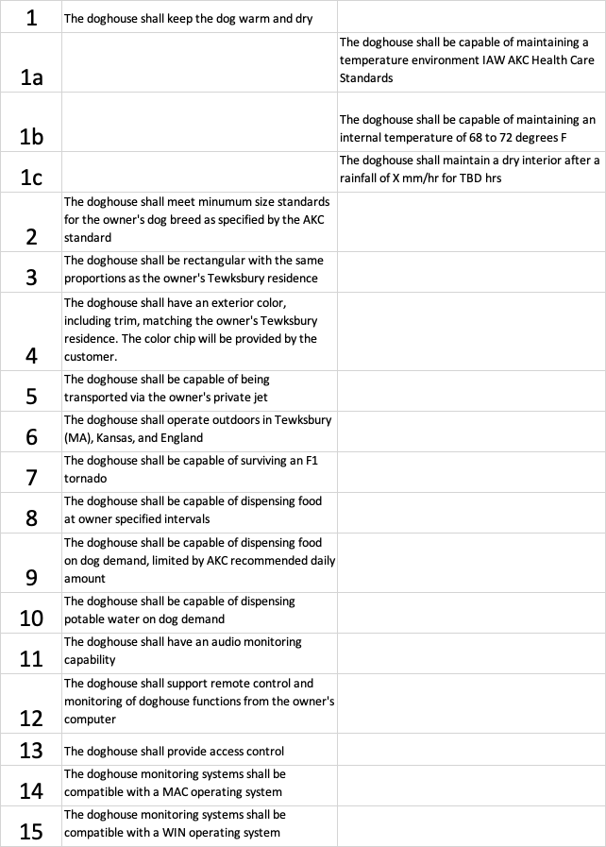

Slide 10
Characteristics of Good Requirements
Well-written requirements are essential for project success, including the following key characteristics.
Necessary. State only what is determined to be necessary for achieving the client’s mission.
Clear. Convey what must be achieved in a manner that can be understood by those who are expected to implement the requirement, without having to ask the author what was meant.
Achievable. Confirm with the implementer that the requirement can be affordably achieved either by previously developed means, or within a reasonable period of development.
Traceable. Ensure derived requirements can be traced to a user need or a higher-level specification.
Verifiable. Requirements must be stated in a manner that compliance can be objectively confirmed. Typical methods of confirmation include analysis, inspection, demonstration and test.
Complete. A set of requirements needs to be complete, such that if all are met then the resulting system will successfully achieve the client’s need for the system. In addition, the needs of other stakeholders will be addressed to the agreed extent, and the regulations will be met.
Implementation Free. State what is required and how well it needs to be done without bias for how it will be done. The design team should be allowed to choose the best means of accomplishing the requirements. This helps to provide stable requirements and to control cost.

Slide 11
Place and Paste Project Example

Slide 16
System Specification can be thought of as a technical version of the problem statement. It does not propose a solution.

Slide 22
For now, just keep track of your # hours spent in ECE-304.
Don’t inflate them. This data is for you!

Slide 23
Assignment
Next week: Q&A With the pretend customer. Your chance to ask clarifying questions about build1.
2 Weeks: PDR1: Problem Statement, System Specification, Block Diagram for your system

Slide 24
Example of Last Year’s Q&A:
Q. How are we detecting presence on both sides of the door?If we are only given a single Ultrasonic Sensor, how are we detecting an approaching person on both sides of the door? Yes, we could use a button on one side but that seems to go against the instructions saying "approaching."
A. At this stage, we are focusing on requirements, rather than design and implementation. So the question to ask is whether it is a requirement to automatically detect persons approaching the door from both sides.
is it a requirement to automatically detect (ie, without a pushbutton or other manual means of announcing presence) persons approaching the door from the outside (entering persons) ?
No. It is desirable but not required.
is it a requirement to automatically detect persons approaching the door from the inside (exiting persons) ?
Yes.

